Slide 1
Lecture_05

Slide 2
ADDITIONAL EXERCISE
No. 25

Slide 3

PROBABILITY
Finding Probability : Sum based on
Playing cards

Slide 4
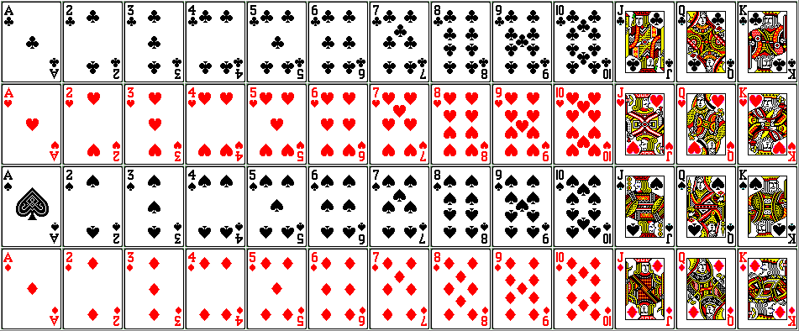
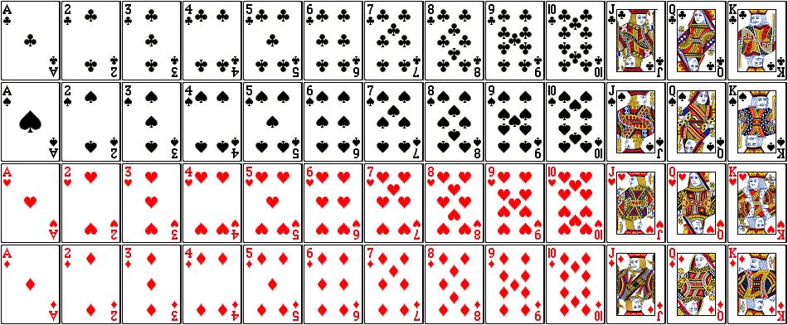






Q. A card is drawn at random from a well shuffled pack of 52 cards.
Find the probability that the card drawn is.
(i) bears a number between 4 and 7 both inclusive.
(ii) bears a number between 3 and 8 both inclusive.
Sol.
There are 52 cards in a pack of cards
∴ Total no. of all possible outcomes = 52
(i) Let A be the event that card drawn bears a number
between 4 and 7 both inclusive.
There are 4 numbers from 4 to 7 inclusive of both
and there are 4 types of cards
Numbers between 4 and 7 both inclusive means
4, 5, 6, 7
∴ Total no. of cards bearing numbers from 4 to 7
inclusive in the pack of cards are 4 × 4 = 16
Number of outcomes favourable to A = 16
Probability of event A is
$$16$$
$$4$$
∴ P (A)
$$=$$
$$=$$
$$\text{52}$$
$$\text{13}$$
Notes:
^%

Slide 5





Q. A card is drawn at random from a well shuffled pack of 52 cards.
Find the probability that the card drawn is.
(i) bears a number between 4 and 7 both inclusive.
(ii) bears a number between 3 and 8 both inclusive.
Sol.
Let B be the event that card drawn bears a number
between 3 and 8 both inclusive.
There are 6 numbers from 3 to 8 both
inclusive and there are 4 types of cards
Total no. of card bearing number from 3 to 8 both
inclusive in the pack of cards is 6 × 4 = 24
n (B) = 24
Numbers between 3 and 8 both inclusive means
3, 4, 5, 6, 7, 8
$$24$$
$$6$$
Probability of event B is
∴ P (B) =
$$=$$
$$\text{52}$$
$$\text{13}$$

Slide 6
ADDITIONAL EXERCISE
No. 26

Slide 7
15. PROBABILITY
Finding the probability sum based on playing cards.
Notes:
School
7

Slide 8
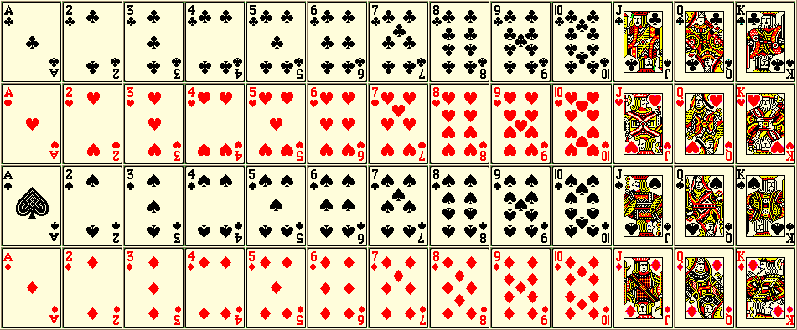
Q.] If a card is drawn from a pack of 52 cards. Find the Probability of getting :
Event A : black card (ii) Event B : not a black card
(iii) Event C : a card bearing number between 2 to 5 including 2 and 5.
Not a black card means only Red cards
52 cards
Numbers between 2 & 5 including 2 & 5
2, 3,4, 5
Probability of event A is
There are 52 cards in a pack
Probability of event B is
Sol.
C be the event that card drawn bears number between 2 and 5 including 2 and 5
∴ Total no. of cards = 52
Probability of event C is
A be event that the card drawn a
black card
No. of cards between 2 and 5 including 2 and 5 is 4.
Total no. of black cards = 26
Total no. of black cards
52 cards
P(A) =
52 cards
There are 4 types of cards
Total no. of cards
52 cards
∴ 4 × 4 = 16
26
1
∴ P(A) =
=
52
2
P(C) =
Total no. of favorable cards
B be the event that the card drawn
is not a black card
Total no. of cards
16
Total no. of red cards = 26
∴ P(C) =
52
P(B) =
Total no. of red cards
Total no. of cards
∴ P(C) =
4
13
26
1
∴ P(B) =
=
52
2

Slide 9

Q.] A card is drawn at random from well shuffled pack of 52 cards.
Find the probability that the card drawn is :
(i)
a spade
(ii)
not of diamond
Probability of event A is
Probability of event B is
There are 52 cards in a pack
Sol:
There are 52 cards in a pack
Total no. of cards
=
52
(i)
(ii)
Let B be event that the card drawn is not
Let A be event that the card drawn is
52 cards
a diamond
a spade card
52 cards
There are 39 cards which are not a diamond
There are 13 spade cards
Total no. of spade cards
P
Total no. of favorable cards
(B)
P
=
(A)
=
Total no. of cards
Total no. of cards
There are 13
Diamond cards
39
13
P
∴
P
∴
(B)
=
(A)
=
52
52
∴
P
(A)
=
1
(B)
=
3
∴
P
4
4

Slide 10
ADDITIONAL EXERCISE
No. 27

Slide 11
15. PROBABILITY
Finding the probability sum based on playing cards.
Notes:
School
11

Slide 12
Q.] One card is drawn from a well- shuffled pack of 52 cards.
Find the probability of getting :
(i) a king of red colour. (ii) a face card. (iii) a red face card.
Sol.
There are 52 cards in a pack
Probability of event A is
Total no. of cardss = 52
52 cards
(i) Let A be the event that card drawn is a king of red colour
52 cards
... There are 2 kings in red colour
Total no. of favorable cards
P (A) =
Total no. cards
2
1
∴ P (A) =
=
52
26

Slide 13
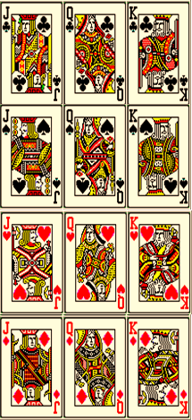
Q.] One card is drawn from a well- shuffled pack of 52 cards.
Find the probability of getting :
(i) a king of red colour. (ii) a face card. (iii) a red face card.
Sol.
There are 52 cards in a pack
Total no. of cards = 52
52 cards
Probability of event B is
Let B be the event that card drawn is a face card
... There are 3 face cards in each of the 4 types
∴ The total no. of face cards = 4 × 3 = 12
Total no. of face cards
P (B) =
Total no. of cards
12
3
∴ P (B) =
=
52
13

Slide 14
Q.] One card is drawn from a well- shuffled pack of 52 cards.
Find the probability of getting :
(i) a king of red colour. (ii) a face card. (iii) a red face card.
Probability of event C is
Sol.
There are 52 cards in a pack
Total no. of cards = 52
(iii) Let C be the event that the card drawn is a red face card
52 cards
... There are 3 face cards in each of the 2 red cards
∴ The total no. of red face cards = 2 × 3 = 6
Total no. of favorable cards
P (C) =
Total no. of cards
6
∴ P (C) =
52
3
∴ P (C) =
26

Slide 15
ADDITIONAL EXERCISE
No. 28

Slide 16
15. PROBABILITY
Finding the probability of a four turning up at least once in two tosses of a fair die
Notes:
School
16

Slide 17
Q.] Find the probability of a four turning up at least once
in two tosses of a fair die.
Favourable elements of A are
Sol.
The sample space when a fair die is tossed twice.
The given event is
Probability of event A is
Total outcomes = (1, 1), (1, 2), (1, 3), (1, 4), (1, 5), (1, 6),
The number 4 should
appear at least once
(2, 1), (2, 2), (2, 3), (2, 4), (2, 5), (2, 6),
(3, 1), (3, 2), (3, 3), (3, 4), (3, 5), (3, 6),
(4, 1), (4, 2), (4, 3), (4, 4), (4, 5), (4, 6),
Either on 1st die
or on 2nd die
or on both the dice
(5, 1), (5, 2), (5, 3), (5, 4), (5, 5), (5, 6),
(6, 1), (6, 2), (6, 3), (6, 4), (6, 5), (6, 6).
Total possible outcomes are
Total possible outcomes = 36
Let A be the event of getting 4 at least once in two tosses of a fair die.
(1, 4), (2, 4), (3, 4), (4, 1), (4, 2), (4, 3), (4, 4), (4, 5), (4, 6), (5, 4), (6, 4)
No. of favorable outcomes = 11
No. of favorable outcomes
11
∴ P (A) =
∴ P (A)
=
Total possible outcomes
36

Slide 18
ADDITIONAL EXAMPLE
X_CBSE_2017-18_Mod_30
No. 29

Slide 19
15. PROBABILITY
Finding the probability that the helicopter is crashed inside the lake
Notes:
School
19

Slide 20
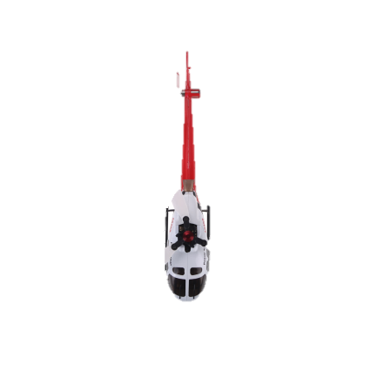








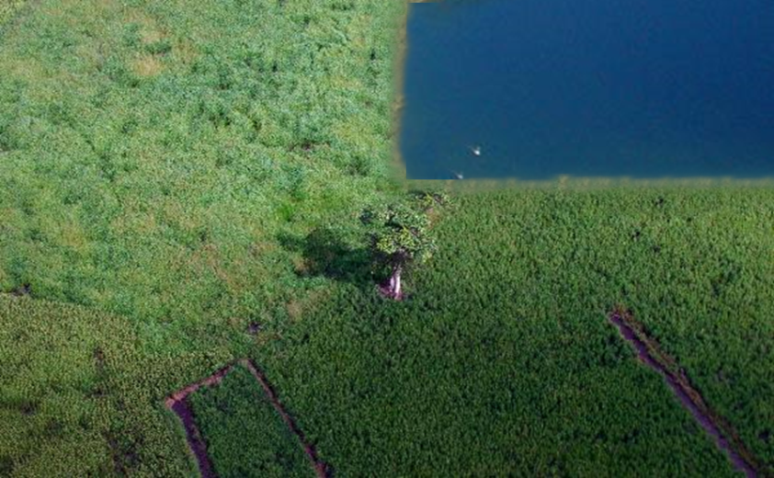
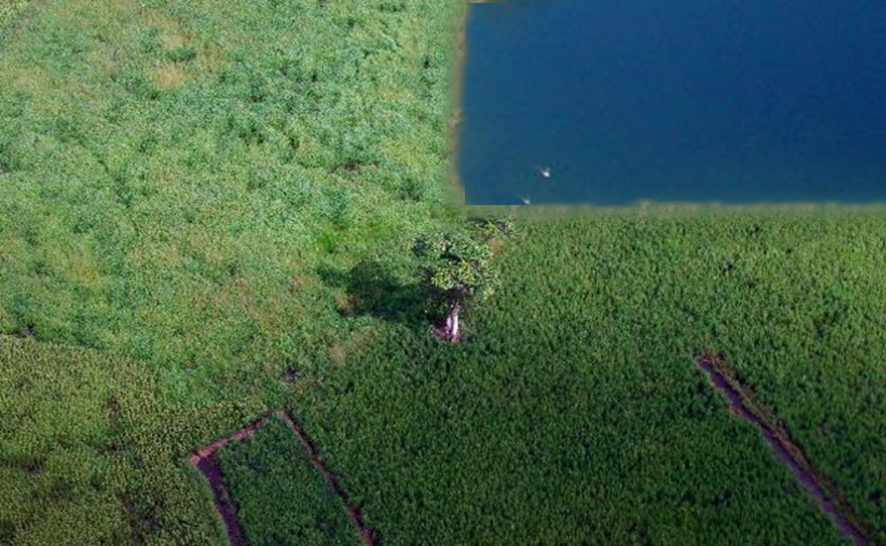



6 km
6
3 km
Q.) A missing helicopter is reported to have
crashed somewhere in the rectangular region
shown in fig .What is the probability that
it crashed inside the lake shown in the fig?
–
Lake
–
2.5 km
Area of the rectangular lake = Length of the rectangular lake × Breadth of the rectangular lake
4.5 km
Sol:
What is given to us?
4.5
Length of the rectangular region =
What do we need to find?
9 km
What do we need to find?
Breadth of the rectangular region =
4.5 km
2 km
∴ Area of the rectangular region =
9 × 4.5
2
No. of favourable outcomes to event A
Total no. of possible outcomes
= 40.5 sq.km
9 km
Area of the rectangular region = Length of the rectangular region × Breadth of the rectangular region
9
i.e. Area of a lake
i.e. Area of a rectangular region
3 km
9 – 6 =
Length of the lake =
Probability of event A is
Breadth of the lake =
4.5 – 2 =
2.5 km
7.5
10
7.5
75
∴ Area of the rectangular lake =
3 × 2.5
P(A)
=
=
×
40.5
10
= 7.5 sq.km
40.5
405
Let A be the event that the helicopter would crashed inside the lake
5
∴ P(A) =
Area of rectangular lake
27
∴ P(A) =
Area of rectangular region

Slide 21
Thank You

